Slide 1


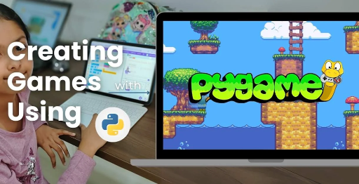
Session 5
Object-Oriented Programming in PyGame

Slide 2
Learning Objectives
Understand the OOPS concepts in the Pygame OMOGAME inspiration
“Let’s build smarter games using Python Classes”
👉 Overview of OOP and its importance in games like OMOGAME
Detailed Objectives:
Learn object-oriented programming (OOP) concepts (classes, objects, methods).
Define core game classes (Bird, Block, Alien, Powerup) in classes.py.
Create test instances of game objects.

Slide 3
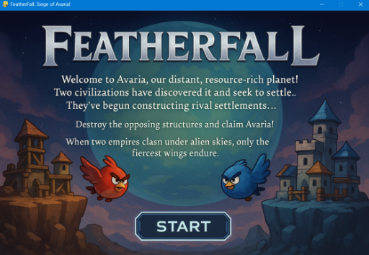
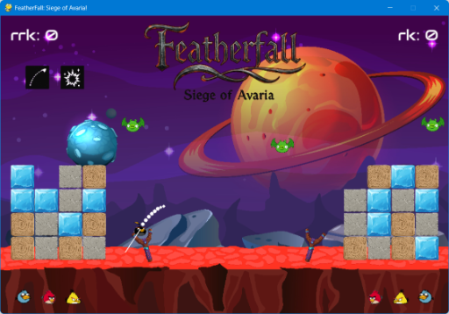
Learning Objectives
“Let’s build smarter games using Python Classes”

Slide 4
Practical Tasks
Understand the OOPS game inspiration, install Pygame-CE, navigate project structure
Practical Tasks:
Write the Bird class with attributes (position, velocity, type) and a method to update position.
Define the Block class with health and position attributes.
Create Alien and Powerup classes with placeholder attributes (e.g., position, type).
Test by creating and rendering a bird and block on the screen in main.py.
Discuss how OOP makes game development modular.

Slide 5
Deliverables
Understand the OOPS concepts in the Pygame OMOGAME inspiration
Session Deliverables:
classes.py with Bird, Block, Alien, and Powerup classes.
A test screen showing a bird and block rendered.
Tips:
Think of classes like blueprints for game characters.
Draw your game objects on paper to visualize their properties.

Slide 6
Welcome to OOP in Game Design
“Let’s build smarter games using Python Classes”
👉 Overview of OOP and its importance in games like OMOGAME
OOP Overview: OOP organizes code into reusable "objects" for games.
Game Context: Used in OMOGAME to create birds, blocks, and more.
Why Important?: Makes coding easier, faster, and teamwork-friendly.
Student Benefit: Build smarter games like Siege of Avaria!
Get Started: Let’s design with Python classes!
Visuals: Gamepad, code icon; blue gradient background.
Design Notes: Bold title (Montserrat), student avatar excited, flowchart of OOP → Game Design.

Slide 7
What is Object-Oriented Programming?
Understand core OOP terms: 🔹 Class 🔹 Object 🔹 Attribute 🔹 Method
📌 Analogy: Game objects are characters with roles, actions, and traits
Class Defined: Blueprint for game objects (e.g., Bird class).
Object Explained: Instance of a class (e.g., a specific red bird).
Attributes: Properties like position or health.
Methods: Actions like moving or taking damage.
Analogy: Think of objects as characters with roles and traits!
Visuals: Icons for class (blueprint), object (bird); blue theme.
Design Notes: Text boxes for terms, flowchart of Class → Object → Attributes/Methods.

Slide 8
Why Use OOP in PyGame?
Code is modular and reusable
Easier debugging Supports adding new features 📦 Think of each object as a self-contained unit
Modular Code: Break game into small, reusable parts.
Easier Debugging: Fix one class without breaking others.
Add Features: New birds or power-ups are simple to include.
Teamwork: Classes let friends work on different parts.
Game Example: OMOGAME’s classes.py organizes all objects.
Visuals: Puzzle pieces, bug icon; blue background.
Design Notes: Text boxes for benefits, student avatar coding, blue flowchart.

Slide 9
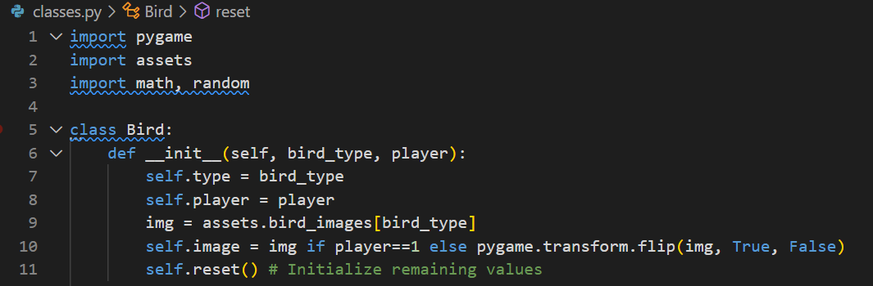
What is Object-Oriented Programming?
classes.py 1 BIRD INIT
CODE SNIPPET:

Slide 10
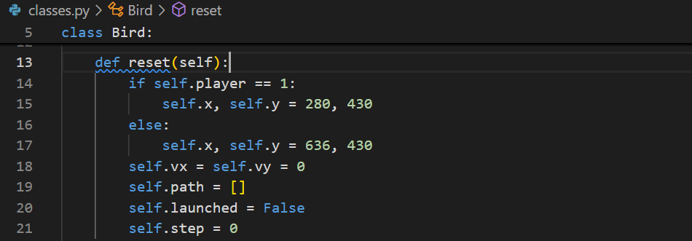
What is Object-Oriented Programming?
classes.py 1 BIRD RESET
CODE SNIPPET:

Slide 11
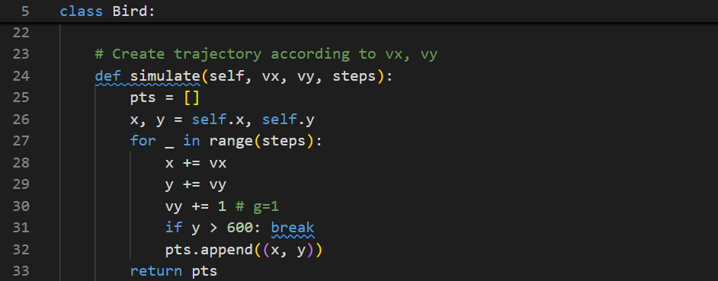
What is Object-Oriented Programming?
classes.py 1 BIRD SIMULATE
CODE SNIPPET:

Slide 12
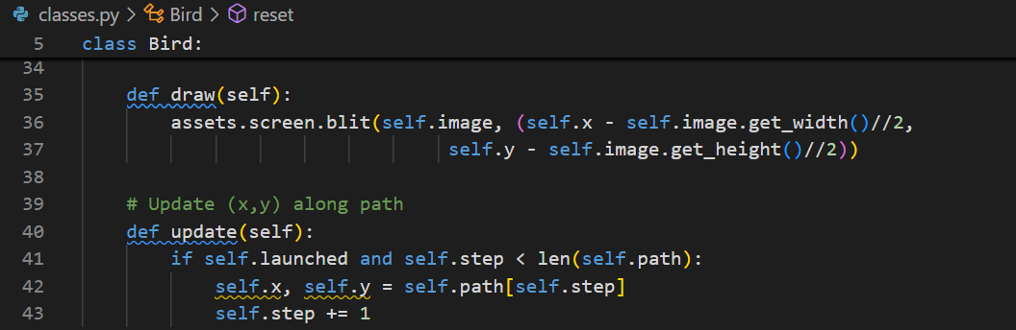
What is Object-Oriented Programming?
classes.py 1 BIRD DRAW
CODE SNIPPET:

Slide 13
Introduction to the Game Characters (Classes)
Game Characters (Classes)
🎯 Bird
🧱 Block
👾 Alien
⚡ PowerUp
🧠 Each one is its own class in classes.py
Bird Class: Launches with velocity, has types (e.g., red).
Block Class: Destructible parts of fortresses with health.
Alien Class: Bonus targets that move around.
PowerUp Class: Boosts gameplay in Basic mode (e.g., double damage).
File Location: Defined in classes.py for OMOGAME.
Visuals: Icons for bird, block, alien, star; green theme.
Design Notes: Green text boxes, diagram of classes, student avatar pointing.

Slide 14
Introduction to the Game Characters (Classes)
classes.py 1 BIRD
CODE SNIPPET:

Slide 15
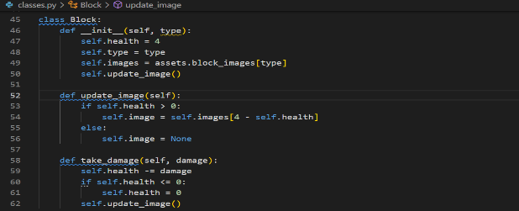
Introduction to the Game Characters (Classes)
classes.py 1 BLOCK
CODE SNIPPET:

Slide 16
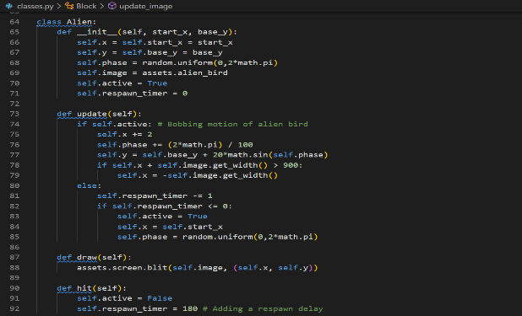
Introduction to the Game Characters (Classes)
classes.py 1 ALIEN
CODE SNIPPET:

Slide 17
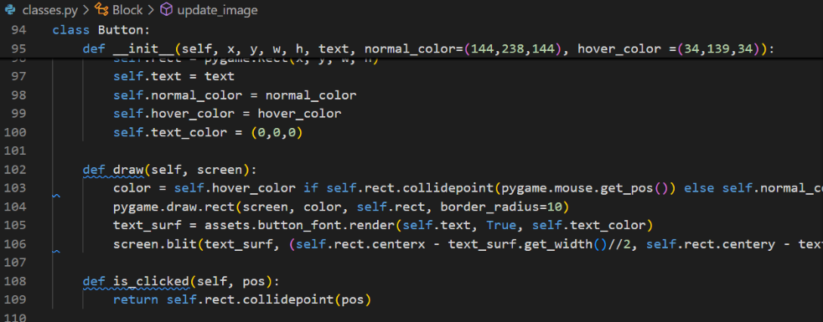
Introduction to the Game Characters (Classes)
CODE SNIPPET: BUTTON

Slide 18
Building the OOPS Class - Bird Class
📍 Attributes: position, velocity, bird type
🔧 Method: update_position()
Attributes: Position (x, y), velocity, bird type (e.g., “red”).
Key Method: update_position() moves bird based on physics.
Code Demo:
class Bird:
def __init__(self, x, y, velocity, type):
self.x = x
self.y = y
self.velocity = velocity
self.type = type
def update_position(self):
# Update position with gravity
self.y += self.velocity
Purpose: Simulates bird’s trajectory in game.
Try It: Add your own bird type!
Visuals: Bird icon, code snippet; purple theme.
Design Notes: Purple code-style text box, flowchart of bird movement.

Slide 19
Creating other OOPS based Block, Alien & PowerUp
Block ➡️ has health + position
Alien ➡️ placeholder for targets
PowerUp ➡️ bonus logic for future modes
📌 Keep it simple with just position/type for now
Block Details: Has health, position; takes damage on hit.
Alien Role: Moving target for bonus points, defined in classes.py.
PowerUp Logic: Adds bonuses like trajectory view in Basic mode.
Keep Simple: Start with position and type for each.
Next Step: Test these in main.py with other objects.
Visuals: Block, alien, star icons; green background.
Design Notes: Green text boxes, diagram of object interactions, avatar designing.

Slide 20
Testing OOP based Objects in main.py
Import classes Create instances:
Import Classes: Bring in Bird, Block from classes.py.
Create Instances Code:
my_bird = Bird(100, 200, 5, "red")
my_block = Block(300, 400, 100)
Render Objects: Use pygame.draw to show them on screen.
Test Run: Run main.py to see objects appear.
Check It: Ensure objects move or interact correctly.
Visuals: Window with bird/block, code icon; purple theme.
Design Notes: Purple code box, student avatar testing, flowchart of test process.

Slide 21
The Power of Modularity
👨‍🔧 Why OOP helps in games:
Separate files = cleaner code
Easy to upgrade one object without breaking the rest
Faster teamwork and debugging
Cleaner Code: Separate files like classes.py keep things tidy.
Easy Upgrades: Add new bird types without breaking game.
Team Coding: Friends can work on different classes.
Debugging: Fix one object without affecting others.
OMOGAME Example: tools.py and classes.py work together smoothly.
Visuals: Puzzle piece, team icons; yellow theme.
Design Notes: Yellow text boxes, flowchart of modular code, avatar collaborating.

Slide 22
Student Exercise – Create Your Own Object
🧪 Task:
Add a new Bird with custom color & effect
Create a PowerUp that doubles score 🎯 Bonus: Draw your object first on paper!
Task Overview: Create a new Bird or PowerUp in classes.py.
Bird Idea: Design a bird with a custom color (e.g., blue) and effect.
PowerUp Idea: Code a power-up that doubles score on hit.
Steps: Sketch idea, code in classes.py, test in main.py.
Showcase: Present your object to the class!
Visuals: Custom bird, star icon; yellow background.
Design Notes: Flowchart of project steps, excited student avatar, yellow text boxes.

Slide 23
OOPs Recap & Deliverables
✅ What you’ll turn in:
classes.py with 4 game object classes
Test output with bird + block on screen 💡 Remember: OOP is your game’s architecture!
What You Learned: Built classes for game objects using OOP.
Deliverables: Submit classes.py with 4 classes, test output with bird/block.
Keep Going: Try adding more features to OMOGAME.
Resources: Pygame docs (pyga.me/docs), YouTube tutorials.
Questions?: Ask your teacher or share ideas!
Visuals: Checkmark, gamepad, book icons; yellow theme.
Design Notes: Checklist layout, student avatar with laptop, yellow text boxes.

Slide 24

Exercise:
1. What is the primary objective of the Quick Mode in OMOGAME?
A) Collect all power-ups before the opponent
B) Launch birds without any destruction
C) Reach a score of 200 points
D) Complete the entire storyline
Answer: C) Reach a score of 200 points
2. Which file is considered the main entry point of the OMOGAME project? A) tools.py
B) main.py
C) assets.py
D) classes.py
Answer: B) main.py

Slide 25
Exercise..
3. What does the tools.py file mainly handle in the game?
A) Launching sound and animation
B) Player avatar selection
C) Collision detection and drawing functions
D) Managing game instructions
Answer: C) Collision detection and drawing functions
4. Which of the following is NOT listed as a unique feature of OMOGAME? A) Bird classes with special physics
B) Alien targets for bonus points
C) Multiplayer online matchmaking
D) Destructible block environments
Answer: C) Multiplayer online matchmaking

Slide 26
Exercise…
5. Why is organizing the OMOGAME project into files like classes.py, media/, and game_modes.py important?
A) It reduces the game’s memory usage
B) It helps reduce the number of bugs completely
C) It makes the project look colorful
D) It simplifies managing and updating different game parts
Answer: D) It simplifies managing and updating different game parts

Slide 27
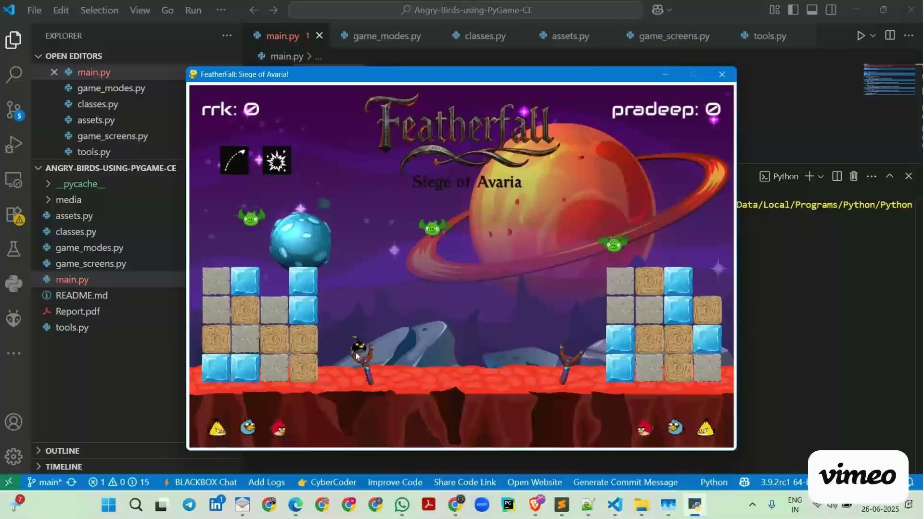
Session 5 VIDEO LINK
Object-Oriented Programming in PyGame

